Slide 1


PYTHON
Lecture 50

Slide 2

Today’s Agenda
Database Programming In Python-II
Introduction To SQLite
Steps Needed For Connecting To SQLite From Python
Exploring Connection And Cursor Objects
Executing The SQL Queries
Different Ways Of Fetching The Data

Slide 3
Introduction To SQLite
SQLite is an Open Source Database developed in C programming language.
It stores data to a text file on the device and is a popular choice for application softwares such as web browsers as well as mobile platforms like Android and iOS.

Slide 4
SQLite Features
Extremely light-weighted (not more than 500 KBs)
No complex setup
Fully transactional.
It supports all standard relational database features like SQL Queries, Joins , Constraints etc

Slide 5
Who Uses Sqlite ?
Following are well known companies/products that use SQLite:
Adobe
Apple
McAfee
Microsoft
DropBox
Facebook
Google
Python
PHP

Slide 6
SQLite Limitations
SQLite supports neither RIGHT OUTER JOIN nor FULL OUTER JOIN. It supports only LEFT OUTER JOIN.
With ALTER TABLE statement in SQLite we can only add a column or rename a table or column.
However, we can't do the following:
DROP a column.
ADD a constraint.

Slide 7
SQLite Limitations
GRANT and REVOKE commands are not implemented in SQLite.
VIEWs are read-only – we can't write INSERT, DELETE, or UPDATE statements into the view.
SQLite only supports FOR EACH ROW triggers, and it doesn't support FOR EACH STATEMENT triggers.

Slide 8
SQLite Installation
Installing and setting up SQLite takes a matter of a few minutes.
We can use SQLite from the command line tools, but there is a GUI-based utility which lets us use SQLite through a decent graphical interface.
This is called DB Browser for SQLite.
We can download it from https://sqlitebrowser.org/dl/ with respect to our OS platform.

Slide 9
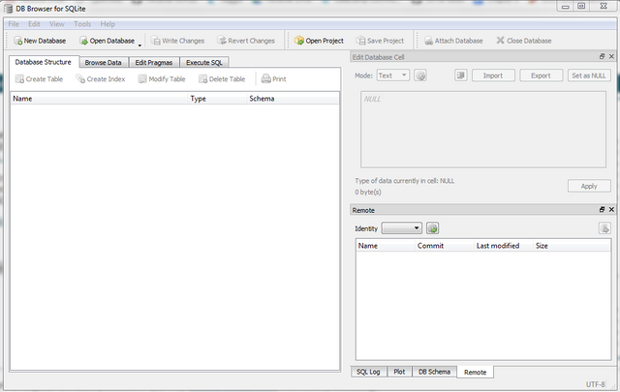
SQLite Installation
On Windows platform, the interface for DB Browser for SQLite looks like this –

Slide 10
Steps Required For Connecting Python Code To SQLite
Connecting our Python app to any database involves total 6 important steps.
Also remember that these steps will always remain same irrespective of the database we are trying to connect
The only difference will be the change in the name of the module

Slide 11
Steps Required For Connecting Python Code To Sqlite
For connecting to SQLite , the steps are:
Import the module sqlite3
Establish a connection to the database.
Create a cursor to communicate with the data.
Execute the SQL query
Fetch the result returned by the SQL query
Close the cursor and connection to the database.

Slide 12
Step 1- Importing The Module
Since we are connecting to SQlite , so all the functions and classes we will be using will be supplied by the module called sqlite3.
So the first step will be to import this module by writing the following statement:
import sqlite3

Slide 13
Step 2- Establishing The Connection
After importing the module ,we must open the connection to the SQlite.
This can be done by calling the function connect( ) of sqlite3 module having the following syntax:
sqlite3.connect( “path to the db file”)
Following is the description of this function:
It accepts a connection string as argument mentioning the path to the db file
If a connection is established, then a Connection object is returned.
If there is any problem in connecting to the database , then this function throws the exception called sqlite3.DatabaseError

Slide 14
Important Attributes/Methods Of Connection Object
When the connection is successful , we get back the sqlite3.Connection object.
This object provides us some important methods which are as follows:
cursor() : Return a new Cursor object using the connection.
close(): Closes the connection
commit(): Commits any pending transactions to the database.
rollback(): Rollbacks any pending transactions.

Slide 15
Step 3- Creating The Cursor
Once we have a connection, we need to get a cursor
A Cursor allows us to send all the SQL commands from our Python code to the database.
It can also hold the set of rows returned by the query and lets us work with the records in that set, in sequence, one at a time.
To get a Cursor object we call the method cursor( ) of the Connection object as follows:
cur=conn.cursor()

Slide 16
Important Attributes/Methods Of Cursor Object
A Cursor object provides us some attributes and methods to execute the SQL query and get back the results
Following are it’s important attributes:
rowcount: Returns the number of rows fetched or affected by the last operation, or -1 if the module is unable to determine this value.
Following are it’s important methods:
execute(statement) : Executes an SQL statement string on the DB
fetchall(): Returns all remaining result rows from the last query as a sequence of tuples
fetchone(): Returns the next result row from the last query as a tuple
fetchmany(n): Returns up to n remaining result rows from the last query as a sequence of tuples.
close(): Closes the cursor

Slide 17
Step 4- The execute( ) Method
Syntax:
execute(SQL statement, [parameters], **kwargs)
This method can accept an SQL statement - to be run directly against the database. It executes this SQL query and stores the result.
For example:
cur.execute('select * from allbooks')

Slide 18
The execute( ) Method
It can also accept Bind variables assigned through the parameters or keyword arguments.
We will discuss this later

Slide 19
Step 5- Fetching The Result
Once we have executed the SELECT query , we would like to retrieve the rows returned by it.
There are numerous ways to do this:
By iterating directly over the Cursor object
By calling the method fetchone()
By calling the method fetchall()
We will discuss each of these methods after step 6

Slide 20
Step 6- Fetching The Result
The final step will be to close the cursor as well as close the connection to the database once we are done with processing.
This is done by calling the method close() on both the objects.
Example:
cur.close()
conn.close()

Slide 21
An Important Point!
During communication with Sqlite , if any problem occurs the methods of the module sqlite3 throw an exception called DatabaseError.
So it is a best practice to execute sqlite3 methods that access the database within a try..except structure in order to catch and report any exceptions that they might throw.

Slide 22
Directly Iterating Over The Cursor
The Cursor object holds all the rows it retrieved from the database as tuples.
So if we iterate over the Cursor object using the for loop , then we can retrieve these rows

Slide 23
Exercise
Assume you have a table called Allbooks in the database which contains 4 columns called bookid, bookname, bookprice and subject.
Write a Python code to do the following:
Connect to the database
Execute the query to select name of the book and it’s price from the table Allbooks
Display the records

Slide 24
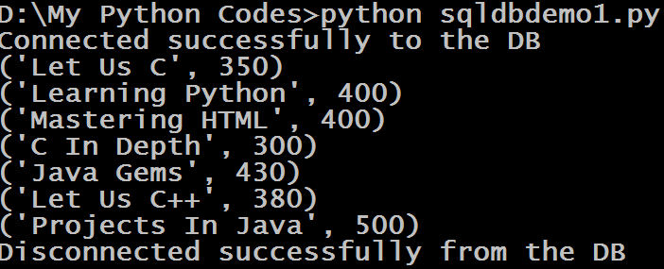
Sample Output

Slide 25
Solution
import sqlite3
conn=None
try:
conn=sqlite3.connect("d:/mysqlitedb/library.db")
print("Connected successfully to the DB")
cur=conn.cursor()
cur.execute("Select bookname,bookprice from allbooks")
for x in cur:
print(x)
except (sqlite3.DatabaseError)as ex:
print("Error in connecting to Sqlite:",ex)
finally:
if conn is not None:
conn.close()
print("Disconnected successfully from the DB")

Slide 26
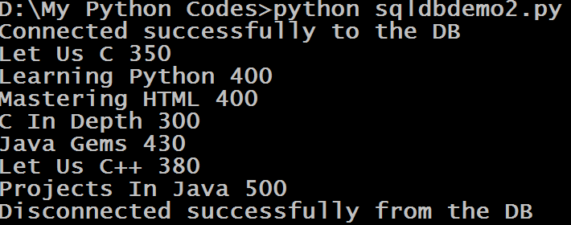
Exercise
Modify the code so that values are displayed without tuple symbol i.e. without the symbol of ( )
Sample Output

Slide 27
Solution
We will just have to unpack each row of the tuple to get the individual values
import sqlite3
conn=None
try:
conn=sqlite3.connect("d:/mysqlitedb/library.db")
print("Connected successfully to the DB")
cur=conn.cursor()
cur.execute("Select bookname,bookprice from allbooks")
for name,price in cur:
print(name,price)
except (sqlite3.DatabaseError)as ex:
print("Error in connecting to Sqlite:",ex)
finally:
if conn is not None:
conn.close()
print("Disconnected successfully from the DB")

Slide 28
Using The Method fetchone( )
Sometimes we may want to pull just one record at a time from the table .
As a result Cursor object provides us a method called fetchone( ) .
This method returns one record as a tuple, and if there are no more records then it returns None

Slide 29
Exercise
Modify the previous code to display the name and price of the costliest book from the table Allbooks

Slide 30
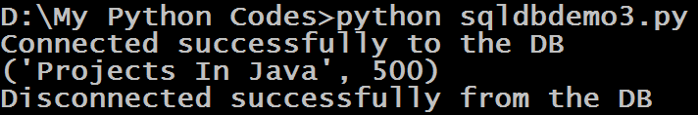
Sample Output

Slide 31
Solution
import sqlite3
conn=None
try:
conn=sqlite3.connect("d:/mysqlitedb/library.db")
print("Connected successfully to the DB")
cur=conn.cursor()
cur.execute("Select bookname,bookprice from allbooks order by bookprice desc")
x=cur.fetchone()
if x is not None:
print(x)
except (sqlite3.DatabaseError)as ex:
print("Error in connecting to Sqlite:",ex)
finally:
if conn is not None:
conn.close()
print("Disconnected successfully from the DB")

Slide 32
Using The Method fetchall( )
Syntax:
cur.fetchall()
The method fetches all rows of a query result set and returns it as a list of tuples.
If no more rows are available, it returns an empty list.

Slide 33
Sample Code
import cx_Oracle
conn=None
cur=None
try:
conn=cx_Oracle.connect("scott/tiger@Sachin-PC/orcl")
print("Connected successfully to the DB")
cur=conn.cursor()
cur.execute("Select bookname,bookprice from allbooks order by bookprice desc")
x=cur.fetchall()
print(x)
except (cx_Oracle.DatabaseError)as ex:
print("Error in connecting to Oracle:",ex)
finally:
if cur is not None:
cur.close()
print("Cursor closed successfully")
if conn is not None:
conn.close()
print("Disconnected successfully from the DB")

Slide 34
Output

Slide 35
Exercise
Modify the previous book application so that your code asks the user to enter a record number and displays only that book .
Make sure if the record number entered by the user is wrong then display appropriate error message

Slide 36
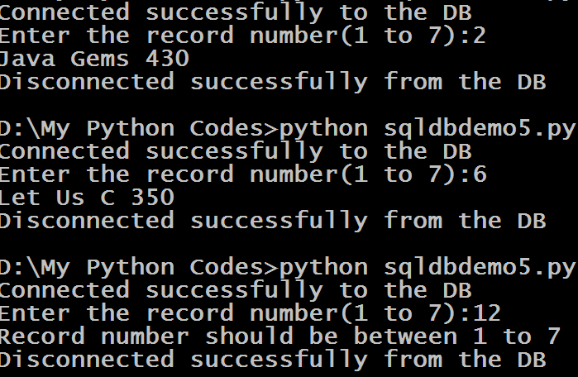
Output

Slide 37
Solution
import sqlite3
conn=None
try:
conn=sqlite3.connect("d:/mysqlitedb/library.db")
print("Connected successfully to the DB")
cur=conn.cursor()
cur.execute("Select bookname,bookprice from allbooks order by bookprice desc")
booklist=cur.fetchall()
recnum=int(input("Enter the record number(1 to "+str(len(booklist))+"):"))

Slide 38
Solution
if recnum <1 or recnum>len(booklist):
print("Record number should be between 1 to "+str(len(booklist)))
else:
row=booklist[recnum-1]
print(row[0],row[1])
except (sqlite3.DatabaseError)as ex:
print("Error in connecting to Sqlite:",ex)
finally:
if conn is not None:
conn.close()
print("Disconnected successfully from the DB")

